Slide 1

DOMESTIC VIOLENCE
by
Naureen Munawar Ali

Slide 2

VIOLENCE
Violence encompasses “physical, visual, verbal or sexual acts that are experienced by a woman or girl as threat, invasion, or assault and that have the effect of hurting her or degrading her and /or taking away her ability to control contact (intimate and otherwise) with another individual”

Slide 3

WHAT IS DOMESTIC VIOLENCE?
Domestic violence is defined in the law as certain criminal acts committed between persons of opposite sex who live together in the same household or who have lived together in the past; or persons who have a child in common or are expecting a child (regardless of whether they have resided in the same household); or persons related to one another in the following ways: spouse, child, grandparent, former spouse, brother, grandchild, parent, sister.

Slide 4

The criminal acts specifically defined in the law are: assault, criminal damage, custodial interference, endangerment, imprisonment, intimidation, kid-napping, trespass, disorderly conduct (by fighting, unreasonable noise, abuse language), or reckless display or discharge of a deadly weapon or dangerous instrument.

Slide 5
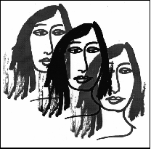
TYPES OF VIOLENCE
Physical: pushing, grabbing, slapping,
kicking, hitting with an object, use of knife
or gun, acid throwing, burning.
Verbal: shouting, making threats, calling
names, humiliating remarks (gestures).
Sexual: forcing intercourse, making her
to do sexual things against her will.
Exercising control: Isolating her from
her family/ friends checking on her, using
the children, economic control.

Slide 6

DOMESTIC VIOLENCE
Is pervasive and insidious.
Is carried out in private domain.
Is inflicted by an intimate partner or as the case may be.
Continues over a period of time (chronic)
Limits avenues of escape for the victim.

Slide 7
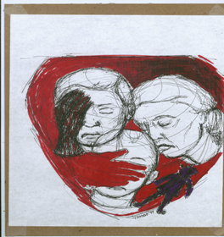
WHY IS VICTIMIZATION OF WOMEN SO COMMON
Physically weak.
Dependency status.
Social tolerance of victimization.
Little whom they associate with.
Limited mobility

Slide 8
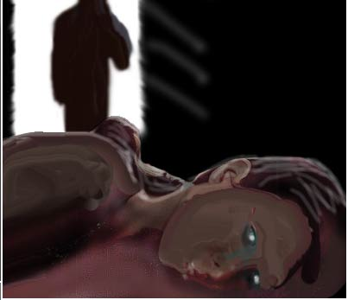

Slide 9
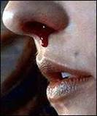
OUTPATIENT DEPARTMENTS OF PSYCHIATRY,
LIAQAT NATIONAL HOSPITAL, PNS SHIFA AND
SOBRAJ HOSPITAL KARACHI.
63% of the participants were identified as victims of domestic violence on Karachi Domestic Violence Screening Scale. 36% of the victims were males and 64% of the victims were females. 35% of the victims reported facing physical abuse, 52% of the victims reported psychological abuse and 30% of the victims reported sexual abuse from their partner. 60% of the victims had depression and 67% of the victims had anxiety.

Slide 10
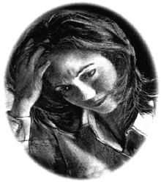
All the respondents admitted to ever shouting or yelling at their wives, including while she was pregnant. Twenty-three (32.8%) respondents admitted to ever having slapped their wives and 54 (77.1%) admitted to ever engaging in a non-consensual sex with their wives
J Pak Med Assoc
Sep 2000;50(9):312-4

Slide 11

HONOR KILLING (KARO-KARI)
According to the findings of Human Rights and Legal Aid Centre in Karachi, in the first three months of 2001, 120 Pakistani women were murdered in the name of Honor Killing. The majority of women were shot to death. Others were axed, burnt and clubbed to death.
264 honor killings in Sindh province in 1999.
According to the Human Rights Commission of Pakistan, “Over 1000 honor killings take place every year in Pakistan and, in the Punjab alone, at least 700 women are raped each year,” and then subsequent honor killing.

Slide 12

GANG RAPE
In 1997 the National Assembly passed a law that provided for the death penalty for persons convicted of gang rape. No executions have been carried out under this law and conviction rates remained low.
It is estimated that less than one-third of all rapes are reported to the police. The police themselves frequently are charged with raping women.
Women are raped to degrade the enemy tribe and hence they rape the opposite tribe’s women as an answer.

Slide 13

Gang rape in particular, is commonly used as a means of social control by landlords and local criminal bosses seeking to humiliate and terrorize local residents.

Slide 14
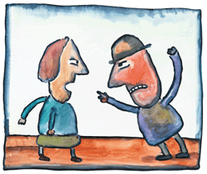
SOUTH ASIA
In Bangladesh women killed by their husbands constitutes 50% of all the homicides in the country
In India, by unofficial estimates, as many as 1,134 dowry deaths took place in first 3 months of marriage (Asia week oct1992)
80% of all Pakistani women are subjected to domestic violence informal study conducted by (women’s division)

Slide 15

77 stove burning cases in 1995 ( a letter from Lahore “dawn” January 26th and 29th 1996)
Human Rights council of Pakistan reported 372 deaths of women due to domestic violence during an 8 month period (The News Karachi, Aug 5th 1994)
Study conducted by final year medical students at AKU found 34% physical abuse in a sample of 150 women.

Slide 16

Deaths attributed to stove blasts (informal survey Punjab)
1988-800
1989-1100
1990-1800
PWA report of 1994 “ Trial by fire” 185 cases some facts:
92% were married.
88% were between ages of 16-25yrs
54% rural.
60% husbands were accused and 21% in laws were accused

Slide 17

Report of 1998 about 706 women raped of which 385 were teenagers or younger about 885 murdered by brother and husbands
(dawn may 30th 1999)

Slide 18

PREVALENCE/ INCIDENCE OF INTIMATE VIOLENCE IN WEST
In the USA, the leading cause of women
going to the emergency wards in hospitals
is the wound they get due to domestic
violence. The number of women wounded
this way is more than the total number of
women wounded in car accidents, mugging
and rape cases.

Slide 19

In Denmark, 25% of women state physical violence to be major cause of divorce.
In Austria, wife abuse was cited as a cause of breakdown in 59% of 1,500 divorced cases ( United Nations 1991).
In Romania, between march 93 and march 94, 28.55% of women in the hospital were there as a result of beating by their husbands or boyfriends. (The Domestic violence in Eastern Europe Project 1995)

Slide 20

In Russia, a formal declaration by the government stated that in 1994, 15,000 women died as a result of their spouse’s violent behavior.
In Papua New guinea, it was shown that 56% of women in urban areas were victims of domestic violence.
In Canada, one in every 4 women are faced with sexual violence at one point in their lives and half of these women are exposed to sexual violence before the age of 16 .

Slide 21
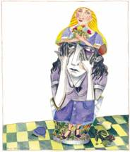
SOME FACTS
It is estimated that about one third of children who are abused or exposed to violence as children become violent themselves in later life.
Boys are at increased risk to abuse an intimate partner in adult relationships if they were abused or witnessed abuse between parental figures.
The sons of the most violent parents had a rate of wife abuse 100 times higher than the sons of the nonviolent parents.

Slide 22

Girls are at increased risk to be abused by an intimate male in adulthood, if they witnessed abuse between parental figures in childhood.
Early physical abuse is a strong predictive factor of criminal behavior in adulthood.
40-75% of children exposed to marital are estimated to be victims of physical child abuse also.
Alcohol use is frequently associated with violence between intimate partners. It is estimated that in 45% of cases of IPV, men had been drinking, and in about 20% of cases, women had been drinking

Slide 23

STUDY BY MEDICAL STUDENTS AKU (CLASS OF 1996)
In a sample of 176 males
27% practiced physical abuse.
76% recognized it as mistreatment.
46% felt men have a right to hit women.
68% practiced isolation.
44% did not see it as abuse.

Slide 24
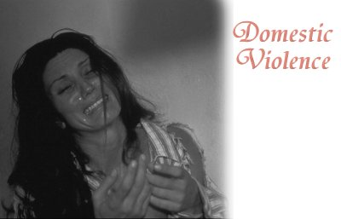

Slide 25

EFFECTS OF DOMESTIC VIOLENCE
Anxiety
Chronic depression
Chronic pain
Death
Dehydration
Dissociative states
Drug and alcohol dependence
Eating disorders
Emotional "over-reactions" to stimuli
General emotional numbing
Health problems
Malnutrition

Slide 26

Panic attacks
Poor adherence to medical recommendations
Repeated self-injury
Self neglect
Sexual dysfunction
Sleep disorders
Somatization disorders
Strained family relationships
Suicide attempts
Inability to adequately respond to the needs of their children

Slide 27

In a 1999 study from Johns Hopkins, it was reported that abused women are at higher risk of miscarriages, stillbirths, and infant deaths, and are more likely to give birth to low birth weight children, a risk factor for neonatal and infant deaths. In addition, children of abused women were more likely to be malnourished and were more likely to have had a recent untreated case of diarrhea and less likely to have been immunized against childhood diseases.

Slide 28

IT’ S HARD TO STOP BECAUSE IT’S HARD TO REPORT!!

Slide 29
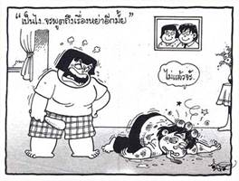
CHALLENGES AS A PHYSICIAN
If a women comes to you with bruises or injuries on her body how would you deal with her ?
As a physician what are our limitations to deal a domestic violence case?
Can we play a significant role in changing the life of the women?

Slide 30

RECOMMENDATIONS
To improve the status of woman within society
Changing perceptions
Education
Easy access to law and order
Stigma related to violence
Moral support of the victim
Emergency management

